Slide 1
dnnImagehandler dynamic Images for DNN 8.0
Torsten Weggen
Indisoftware GmbH

Slide 2
about:me
Torsten Weggen
indisoftware GmbH / Hanover
MVP for DNN 2013 / 2014
VFP-Framework Developer „webmaxx“
Creator of eBay-tool „auctionbuddy“
Since 2008 DNN / NET-developer

Slide 3
about:hobby
Addicted to Google Augmented reality game „Ingress“

Slide 4
about: family

Slide 5
about: fishing for compliments

Slide 6
Why dnnImagehandler ?
Dynamically resize profilepics and every other image as you need them
Add an effect (Greyscale, rotate, invert,..) to the image
Different sources: filesystem, secure, web
Extensability: Create your own graphics

Slide 7
Roots – where does it start ?

Slide 8
Microsoft.Web.GeneratedImage
https://aspnet.codeplex.com/releases/view/16449

Slide 9
Microsoft.Web.GeneratedImage
basic-imagehandler created by microsoft to demonstrate the power of ASP.NET in 2008
More framework then real application
But cool concepts:
Caching (client + serverside)
dynamic pipeline to chain different actions on the image
… and all the magic of System.Drawing

Slide 10
Pipelining

Slide 11
Bitboxx.Web.GeneratedImage
https://bbimagehandler.codeplex.com
Security (no embedding from foreign websites)
Added predefined usable filters
Added special „start images“

Slide 12
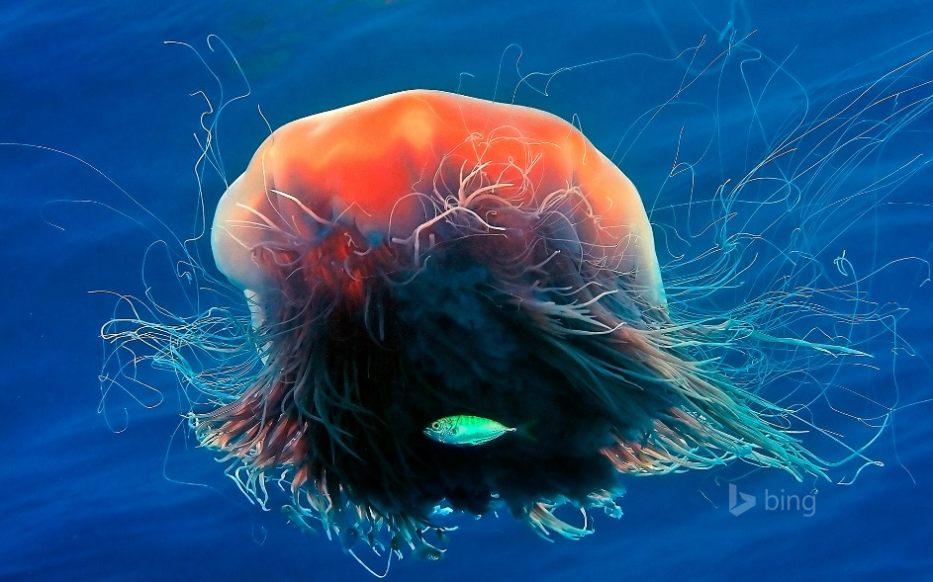
Start Images
Image (local, Database or URL)

Slide 13
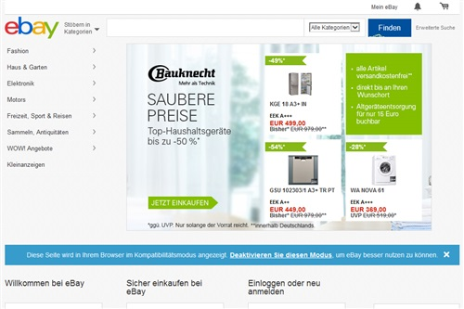
Start Images
Image (local, Database or URL)
Thumbnail of web site

Slide 14
Start Images
Image (local, Database or URL)
Thumbnail of web site
Counter

Slide 15
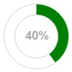
Start Images
Image (local, Database or URL)
Thumbnail of web site
Counter
Percentage marker

Slide 16
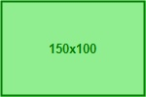
Start Images
Image (local, Database or URL)
Thumbnail of web site
Counter
Percentage marker
Place holder image

Slide 17
Start Images
upca, ean8, ean13, code39, code128, itf, codabar, plessey, msi, qrcode, pdf417, aztec, datamatrix
Image (local, Database or URL)
Thumbnail of web site
Counter
Percentage marker
Place holder image
Barcode

Slide 18
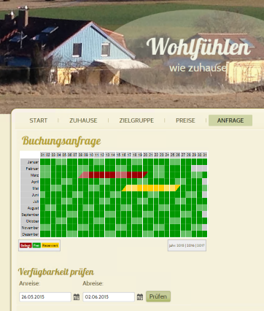
Start Images
Image (local, Database or URL)
Thumbnail of web site
Counter
Percentage marker
Place holder image
Barcode
Booking schedule

Slide 19
Filters
Resize

Slide 20
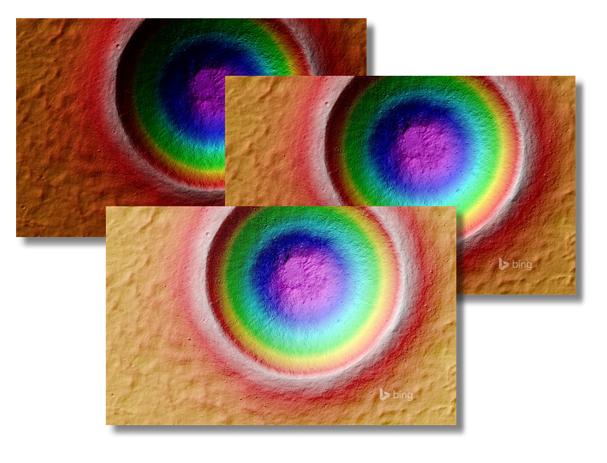
Filters
Resize
Gamma

Slide 21
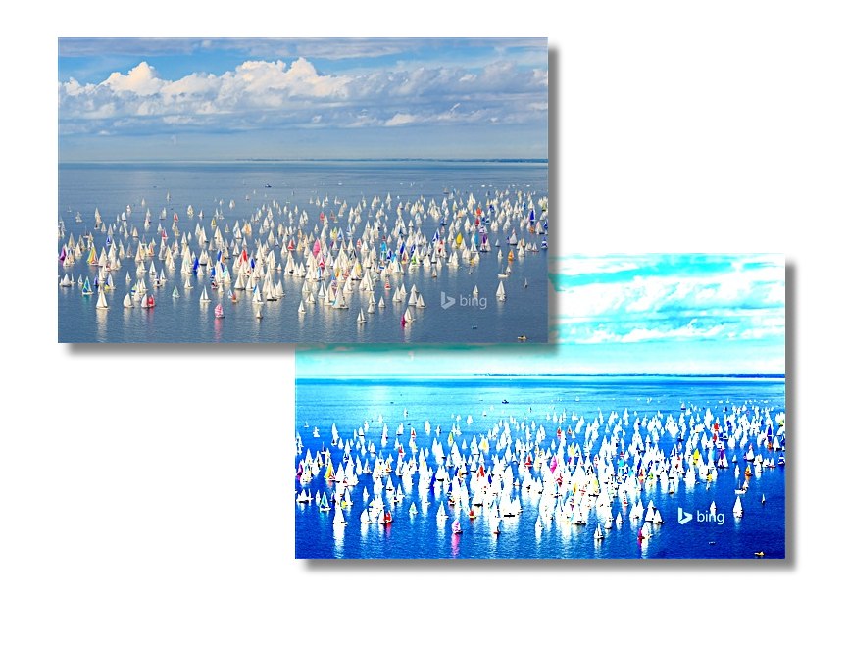
Filters
Resize
Gamma
Contrast

Slide 22
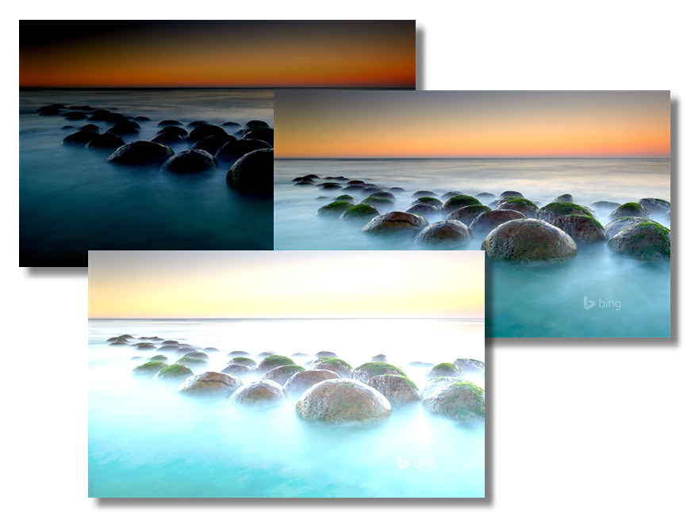
Filters
Resize
Gamma
Contrast
Brightness

Slide 23
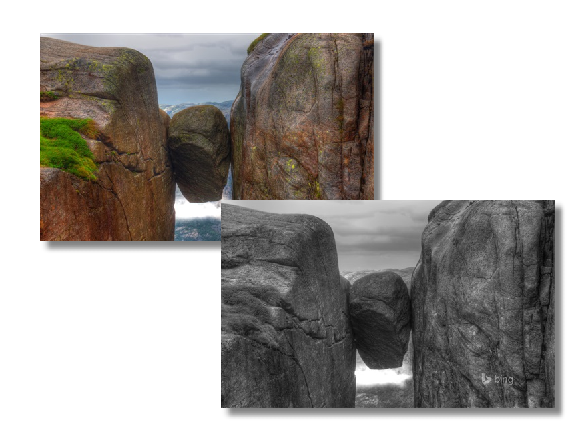
Filters
Resize
Gamma
Contrast
Brightness
Grey scale

Slide 24
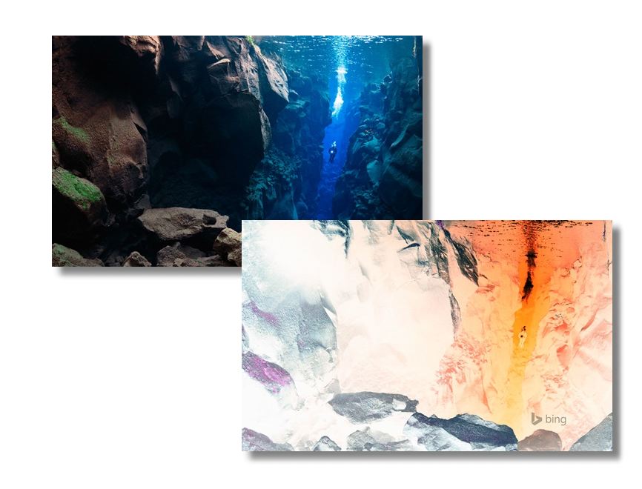
Filters
Resize
Gamma
Contrast
Brightness
Grey scale
Invert

Slide 25
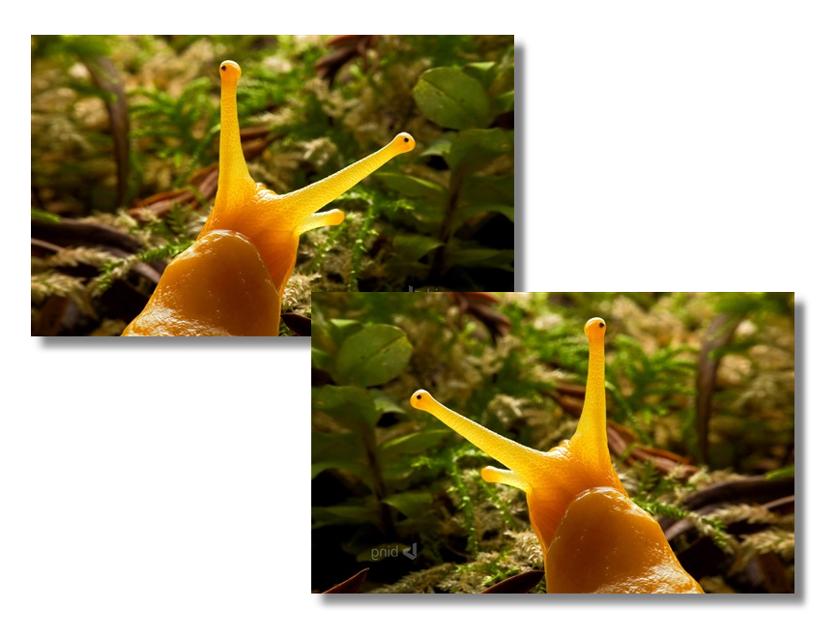
Filters
Resize
Gamma
Contrast
Brightness
Grey scale
Invert
Rotate / Flip

Slide 26
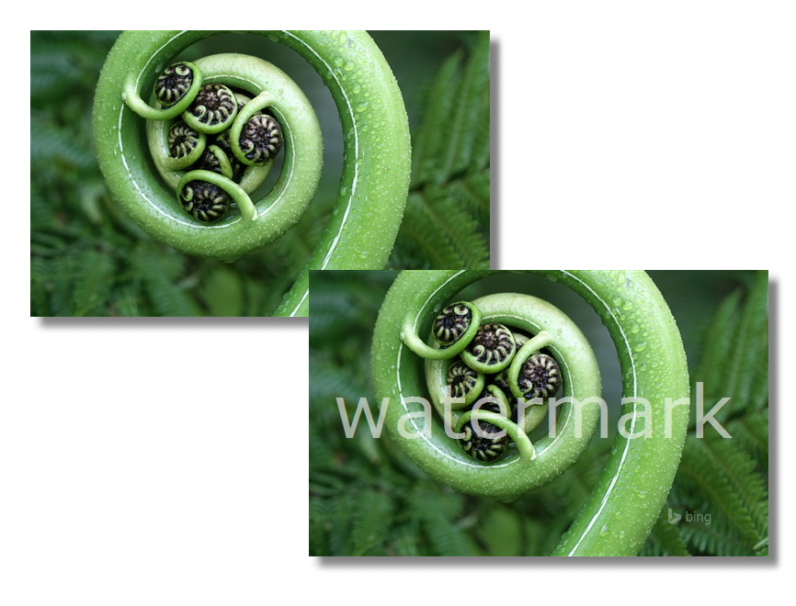
Filters
Resize
Gamma
Contrast
Brightness
Grey scale
Invert
Rotate / Flip
Watermark

Slide 27
Integration in DNN
Part of DNN in version 8
ProfilePic generation
Redesign of architecture
Added security functions (brute force)
No counter, bar code, booking schedule, percentage as start images, but:
Extensibility ! Create your own start images !

Slide 28
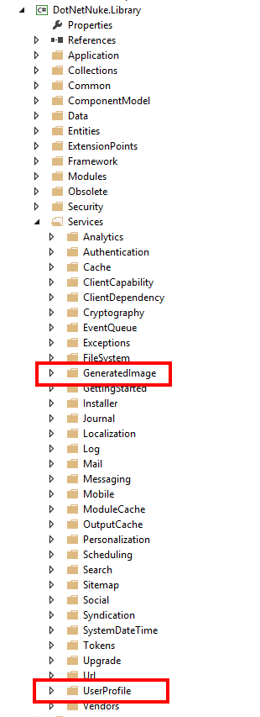
Namespace dnnImageHandler
located in DotNetNuke.Services
(as UserProfile picturehandler)

Slide 29
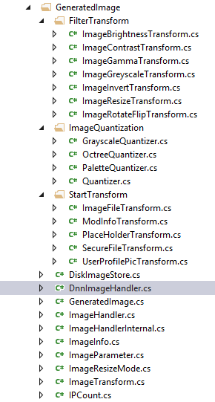
Internal structure
This is how it is organized …

Slide 30
Have a look at dnnImageHandler.cs !

Slide 31
Configuration
Entry in web.config appSettings:
<add key="DnnImageHandler" value="EnableIpCount=false; AllowStandalone=false; LogSecurity=true; AllowedDomains=mydomain.com,otherdomain.net; EnableServerCache=true; EnableClientCache=true;" />

Slide 32
Configuration (IPCount)
Setting | Default | Purpose
EnableIPCount | true | every generation of an image will be counted in App_Data/_ipcount as 192.168.3.15.txt
IPCountMax | 200 | Numbers of image generation allowed from 1 IP in defined timeframe
IPCountPurgeInterval | 300 | Delete IP counts after defined time without any generation from IP.

Slide 33
Configuration (Caching)
Setting | Default | Purpose
EnableServerCache | true | caching of images in folder App_Data/_images
ServerCacheExpiration | 180 | Seconds until the image is deleted from image cache
EnableClientCache | true | Enables the client side caching of images (sends 304)
ClientCacheExpiration | 60 | Seconds caching the image on client site.

Slide 34
Configuration (Other)
Setting | Default | Purpose
AllowStandAlone | false | Allow to open image direct in browser
AllowedDomains | all | If set, only domains here listed are allowed to embed images
ImageCompression | 95 | Quality of generated image (0-100)
LogSecurity | false | Eventlog entry when hitting IP bounderies or AllowedDomains.

Slide 35
DEMO !

Slide 36
Creating extensions
Tom needs a thermometer display for his website marketing his beach resort asap!

Slide 37
Creating extensions
Googling for some clipart

Slide 38
Creating an extension

Slide 39
Creating extensions
Rule of three:
height / 450 = degree / 100
=> height = degree / 100 * 450
objGraphics.FillEllipse(colorBrush, new Rectangle(1, 485, 82, 82));
int height = Convert.ToInt32(( decimal) 450 / 100 * degree + 15);
objGraphics.FillRectangle(colorBrush, 24, 490 - height, 40, height);

Slide 40
Creating extensions
Coding !

Slide 41
Creating extensions
Tom is happy now, hope you too!

Slide 42
Thanks for listening !
Blog: www.bitboxx.net
Email: info@bitboxx.net
Twitter: weggetor

